Slide 1

Multiple Testing & Permutations
Lauren Vanderlinden, PhD, MS
T15 Postdoctoral Fellow Computational Biology
Division of Rheumatology & Department of Biomedical Informatics
School of Medicine, University of Colorado Anschutz Medical Campus
CPBS 7602 - December 10, 2024

Slide 2
Outline
Multiple testing burden
Inflation factor
Methods to adjust for multiple testing
Permutations
Hands on activity

Slide 3
What is Multiple Testing & Why It Is A Problem

Slide 4
Multiple Testing
A single statistical tests carries a 5% risk of producing a false positive conclusion
Generally considered an acceptable level of risk
Repeated tests rack up a much greater (and ultimately unacceptable) risk.

Slide 5
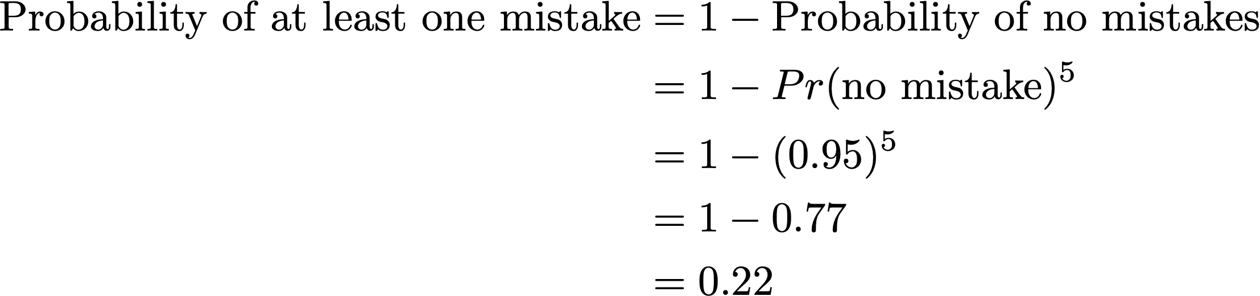
Why is multiple testing a problem?
If we test 20 hypotheses where there is truly no difference, we expect that at one test will have ‘significant’ p-value (p<0.05), e.g., a false positive.
Likewise, the probability of at least one false positive if we perform even 5 tests is:

Slide 6
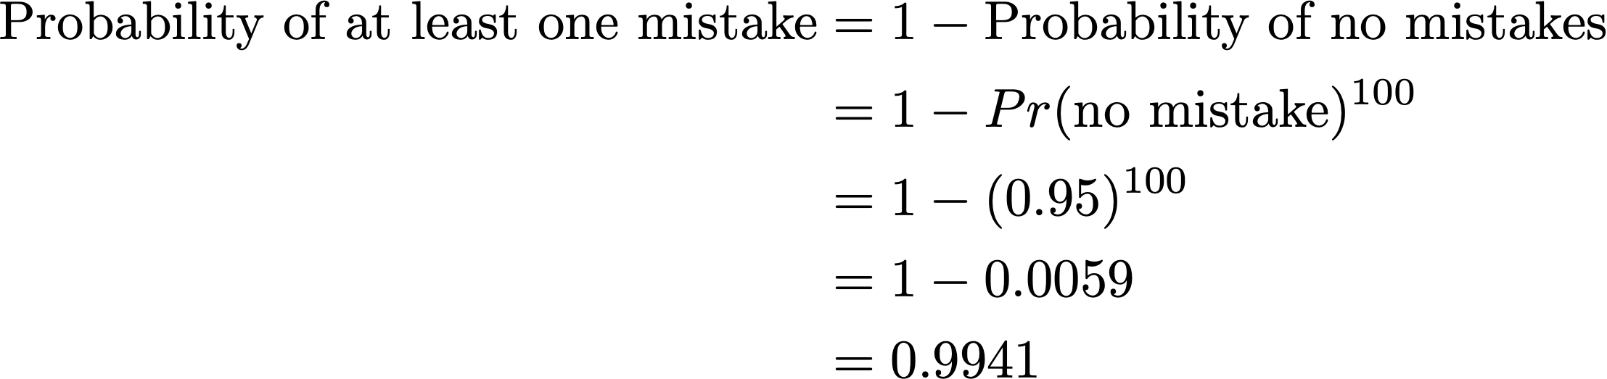

Why is multiple testing a problem?
Taken to extremes, multiple testing is virtually guaranteed to find ‘statistical significance’ even in the absence of any real effects.
Probability of at least one mistake out of 100 tests:
YIKES!

Slide 7
Where does multiple testing arise?
Comparing several treatment groups
Recording numerous endpoints and testing each one for changes
Measuring the same end point on several occasions and testing at each time point
Breaking the data into numerous sub-sets and testing within each of these
Examples: GWAS, Image analyses (voxel-wide testing), survey data, etc.

Slide 8
Comparing multiple treatment groups
If we assess several possible treatments, it is tempting to make all pairwise comparisons.
As the number of groups increases, the number of comparisons increases dramatically, e.g.,
3 groups = 3 comparisons
4 groups = 6 comparisons
10 groups = 45 comparisons
$$n groups = \left(\frac{n}{2}\right)= \frac{n!}{2!\left(n−2\right)!} = \frac{n(n−1)}{2}$$

Slide 9
Comparing several endpoints
It is tempting to measure lots of variables in a study and testing each outcome compared to our intervention.
This is especially true in omics studies where the number of endpoints can range from a few hundred to over a hundred thousand.
This also applies to multiple predictors of the same outcome, e.g., genome-wide association studies

Slide 10
Testing several timepoints
The relevant endpoint is often measured at several time points, and it is tempting to test for differences as each time point.

Slide 11
Testing within numerous groups
It is tempting when results are not statistically significant in the total sample population to begin to break the sample populations into subgroups and check for statistical significance.
But is becomes a slippery slope…
sample
population
males
females
young
middle
aged
old
young
middle
aged
old

Slide 12
Expected distribution of p-values in multiple testing scenarios

Slide 13
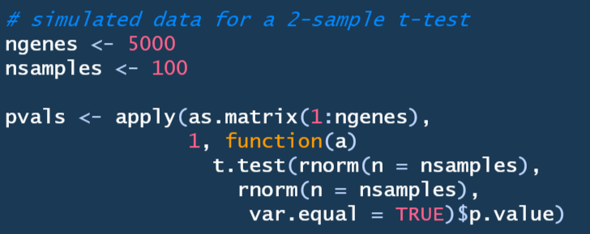
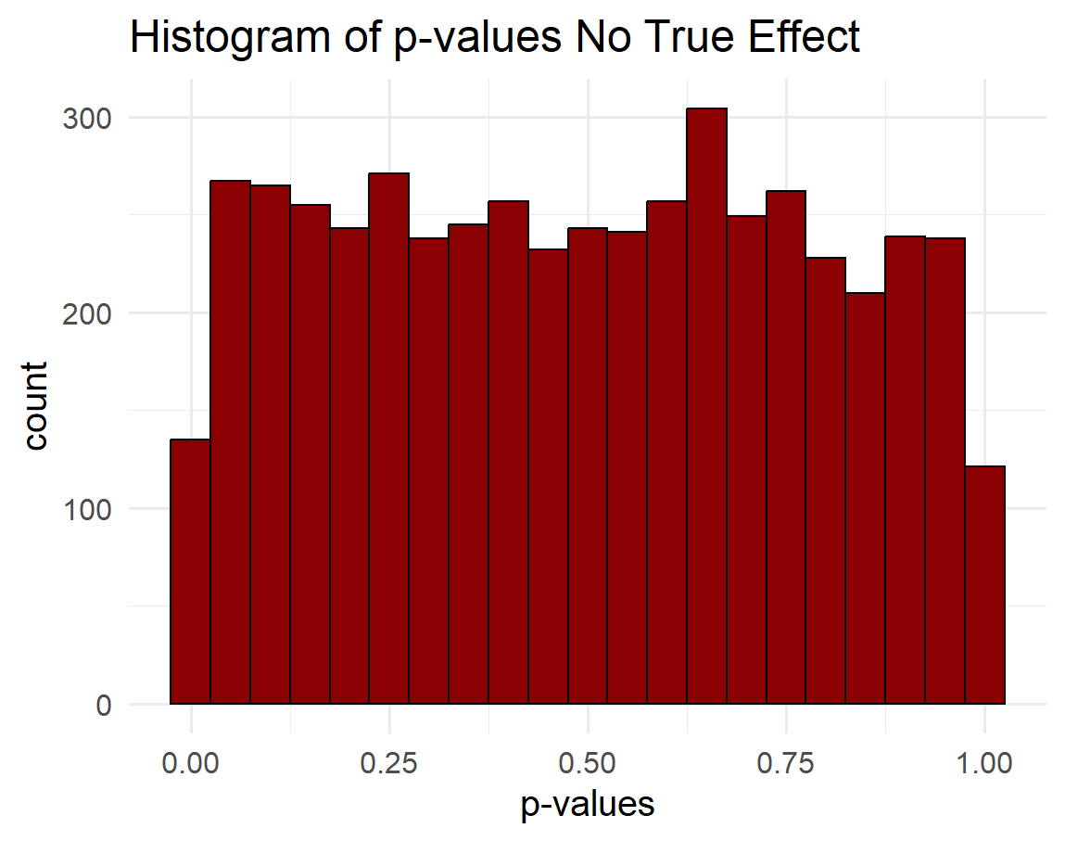
Distribution of p-values when no true effect
UNIFORM
DISTRIBUTION

Slide 14
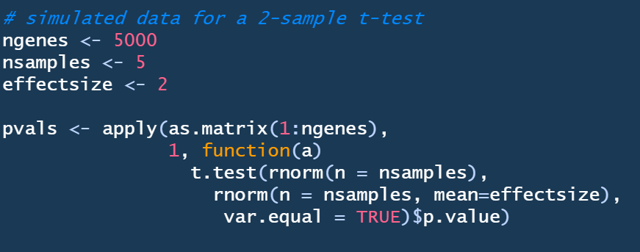
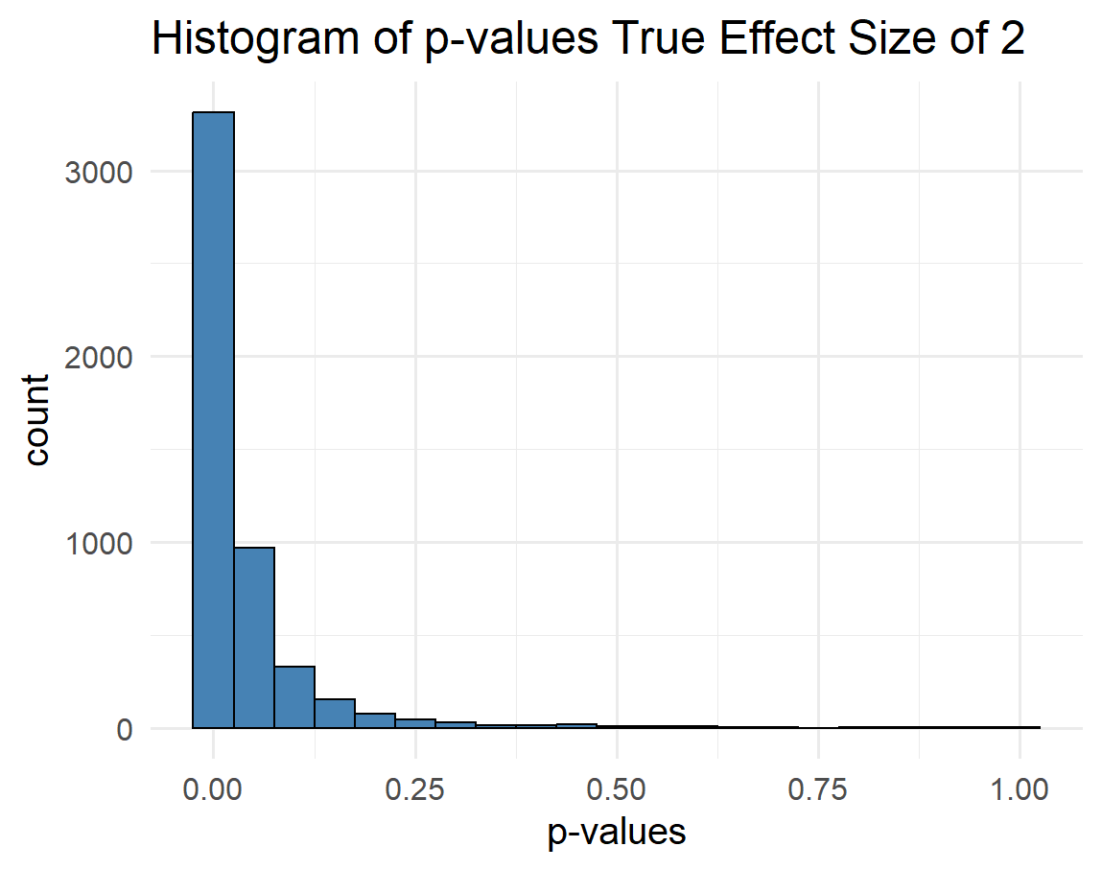
Distribution of p-values when true effect
Mean of group A = 0
Mean of group B = 2

Slide 15
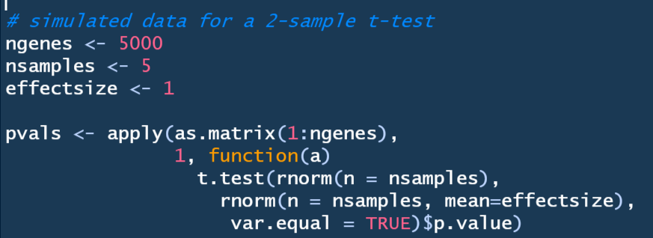
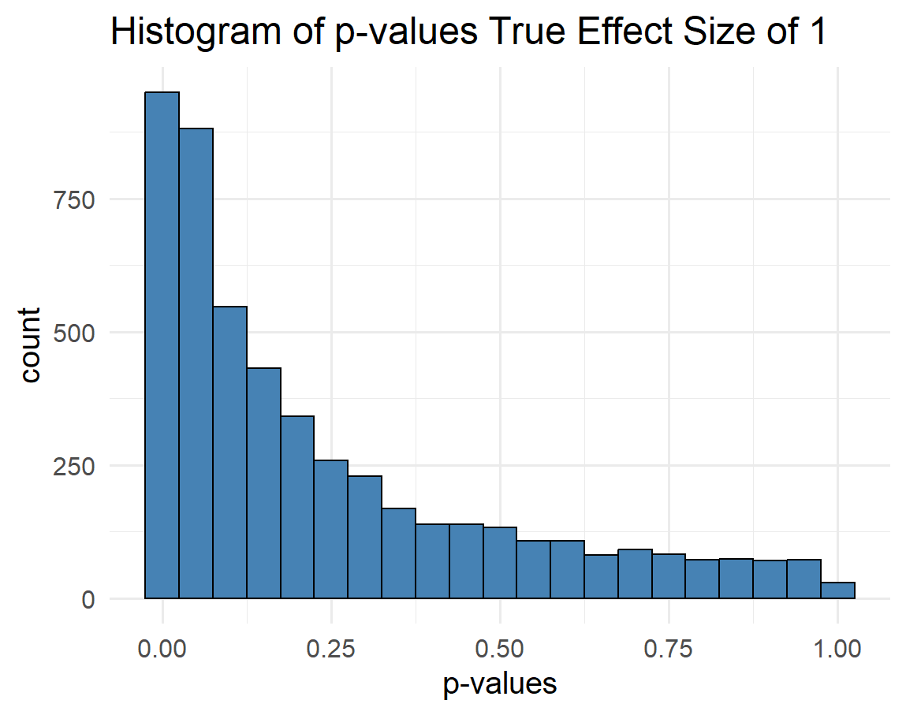
Distribution of p-values when true effect
Mean of group A = 0
Mean of group B = 1

Slide 16
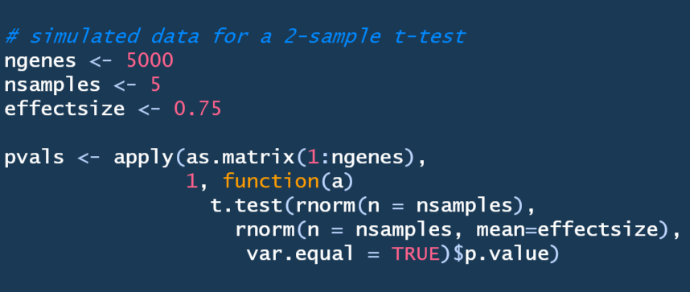
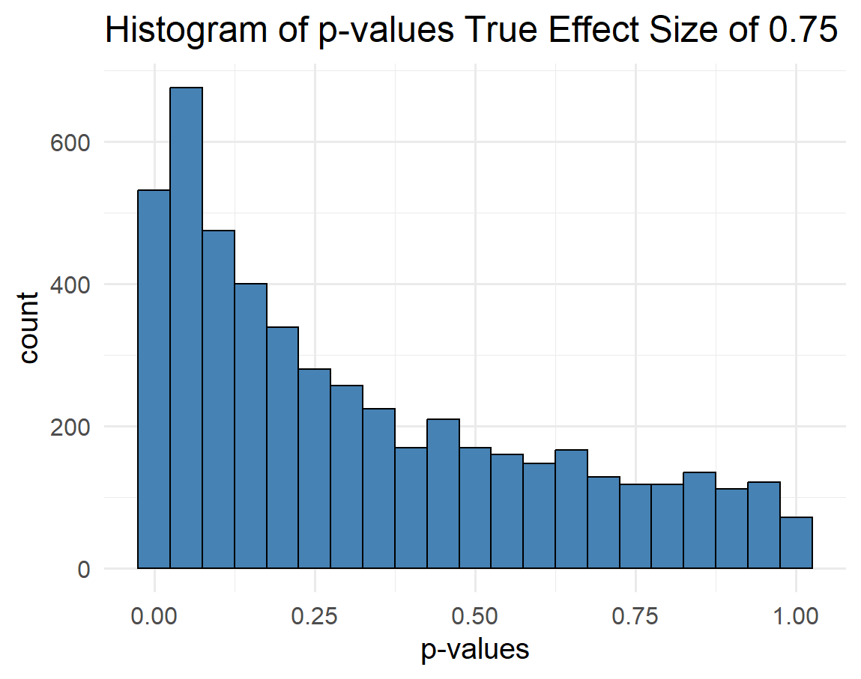
Distribution of p-values when true effect
Mean of group A = 0
Mean of group B = 0.75

Slide 17
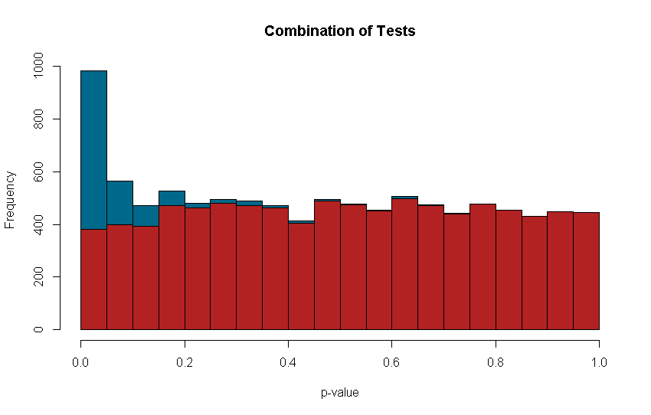
Mix of results
We do not have a nice color coded histogram

Slide 18
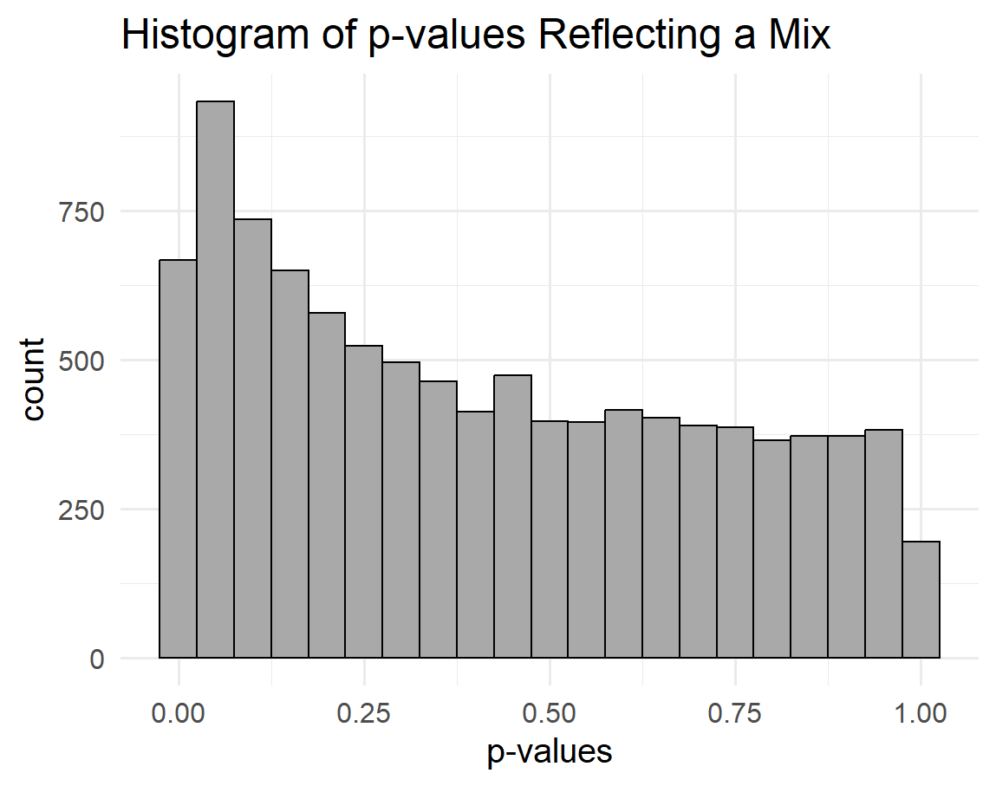
Mix of results
In reality, we will be looking at a distribution like this.
So how do we know what are true differences and what are not?

Slide 19
Q-Q Plots
The Q-Q plot is a graphical representation of the deviation of the observed p-values from the null hypothesis: the observed p-values for each SNP are sorted from largest to smallest and plotted against expected values from a uniform distribution.

Slide 20
Constructing a Q-Q Plot
Rank observed p-values
Calculate expected p-value based on the value at the same rank when assuming a uniform distribution
Plot expected p-value (x-axis) vs. observed p-value (y-axis) – often use the negative log base 10 transformation of both
Examine differences between expected and observed by comparing to a line with 0 intercept and a slope of 1.

Slide 21
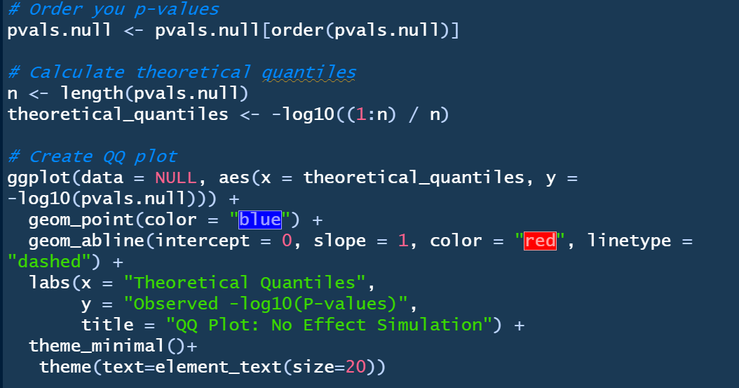
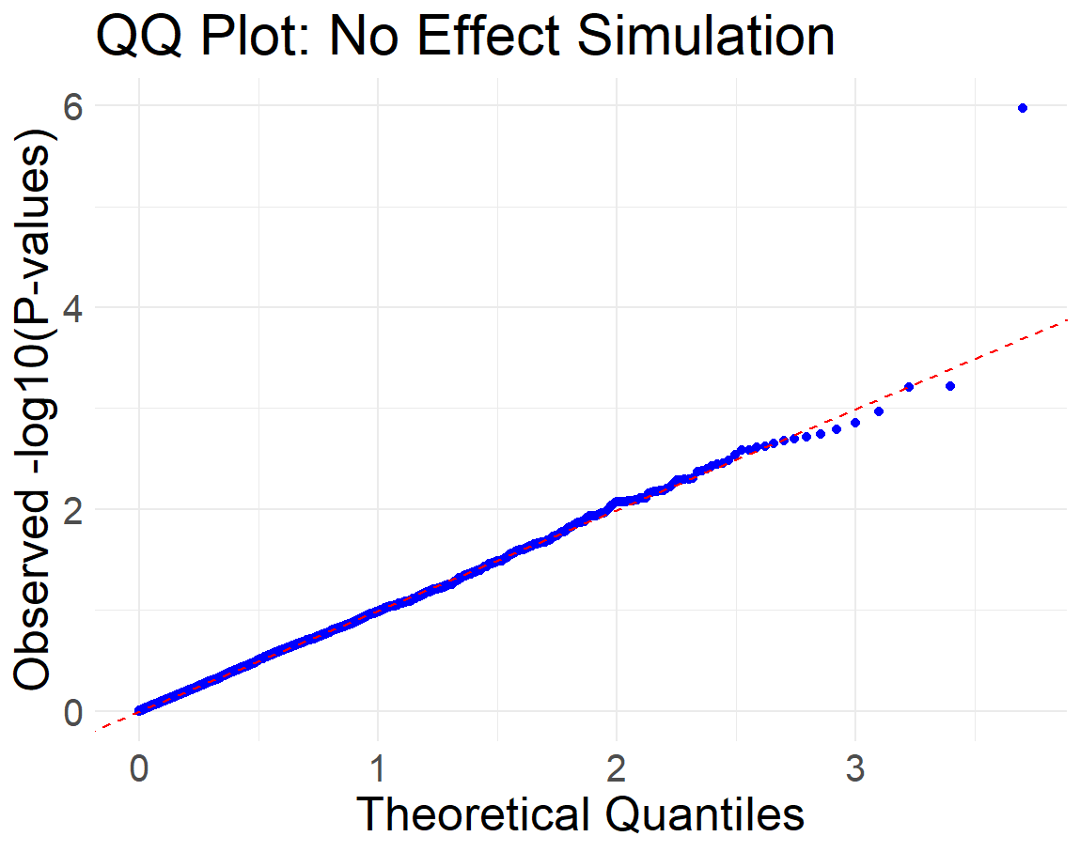
Constructing a Q-Q plot in R
Notice the observered p-values are following the red dotted line very nicely

Slide 22
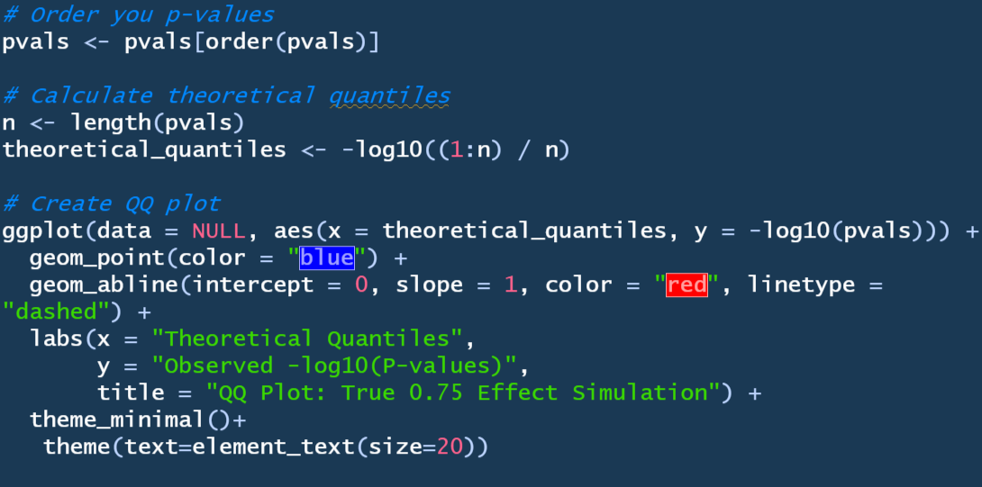
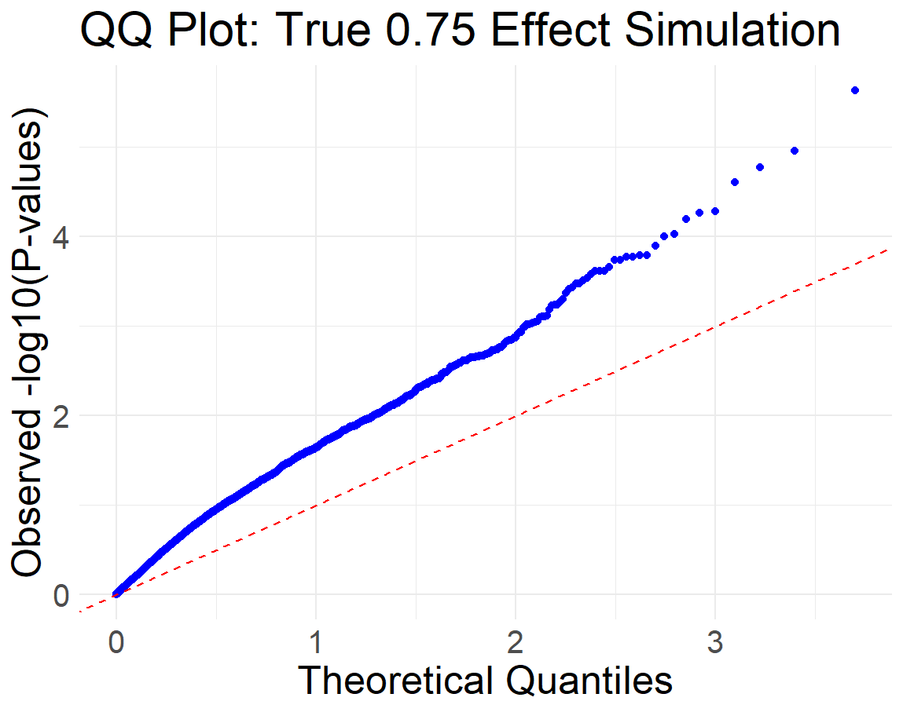
Constructing a Q-Q plot in R
What people would refer to as being “inflated”

Slide 23
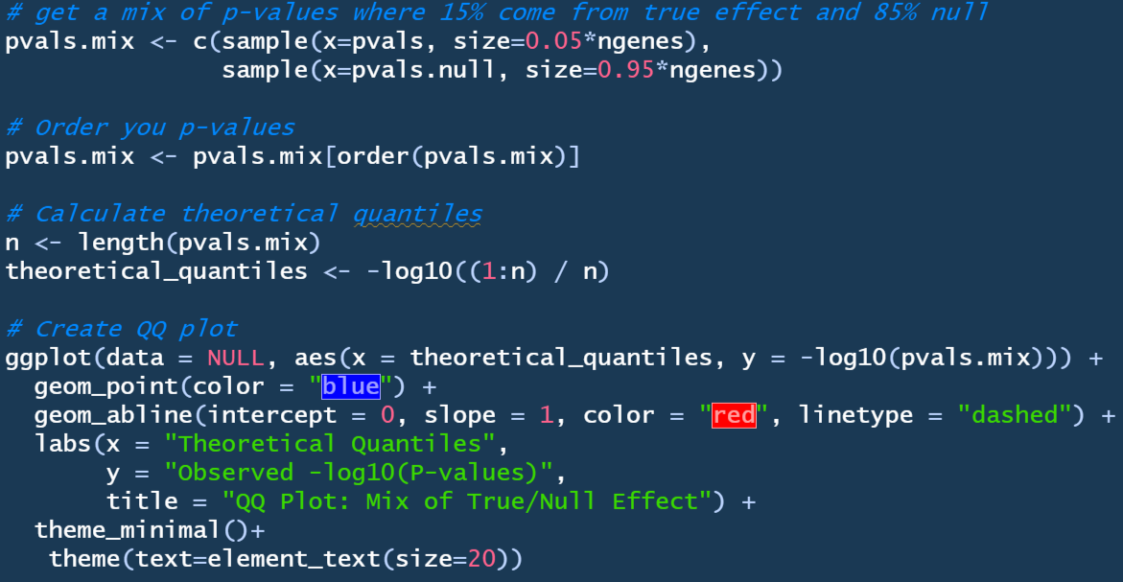
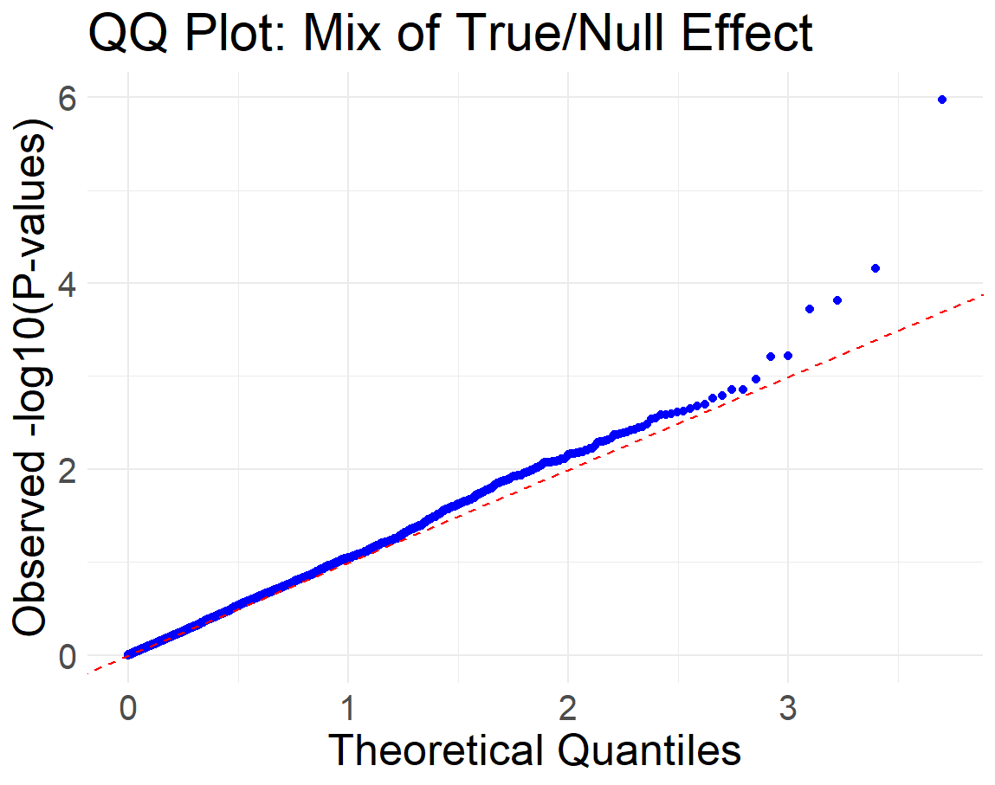
Constructing a Q-Q plot in R
This is what you typically should see. Closely following the line and then a spout at the tail end.

Slide 24
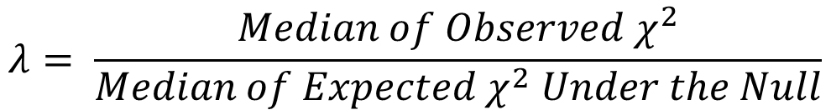
Genomic Inflation Factor (λ)
Assumption 1: The majority of test statistics should follow the null distribution.
Assumption 2: Markers are independent, which might not hold in terms of SNPs (high LD) or other ‘omic markers.
The genomic inflation factor (λ): is a metric used to assess whether a set of test statistics (e.g., from a genome-wide association study) deviates from the null hypothesis.
Used to detect population stratification or technical artifacts that may inflate test statistics
$$λ= \frac{Median of Observed χ^{2}}{Median of Expected χ^{2} Under the Null}$$

Slide 25
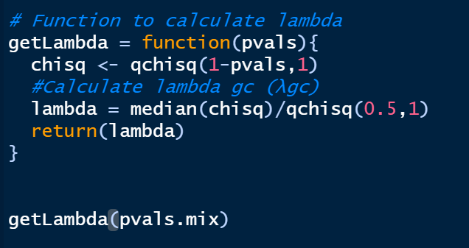
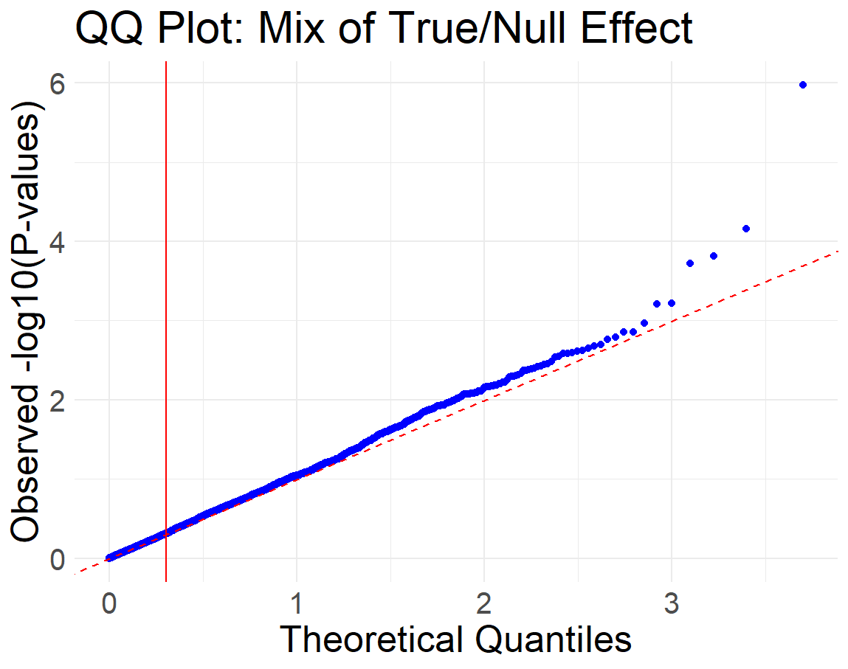

R/Code to Calculate λ
Solid red line is where the median of p-values is located

Slide 26
Example Q-Q plots – with Differential Expression
Few DE Genes
More DE Genes
Lots of DE Genes

Slide 27
Methods to Avoid False Positives
Multiple Testing Adjustment

Slide 28
Use a single (‘omnibus’) test to avoid a series of pairwise comparisons
Multiple treatments - e.g., ANOVA, chi-square with more than two groups, multiple regression, …
Multiple endpoints - multivariate statistics can handle multiple endpoints and allow omnibus testing
Multiple time points - mixed linear models/repeated measures model multiple time points and allow omnibus testing

Slide 29
Distinction between primary and secondary (exploratory) analyses
Another way to avoid the hazards of multiple testing is to highlight one particular route through the experimentation and data analysis.
What is the primary question being asked?
What will be the primary endpoint that answers that question?
What will be the primary statistical analysis of that endpoint?
The identification of a primary analysis must be finalized before the experimental data has been seen.

Slide 30
Secondary (exploratory) analyses
Hypothesis generating vs. hypothesis testing
Not really answers to questions, rather they provide guidance as to what might be useful further research.
“Enjoy the result you have found by exploratory data analysis, for you will not find it again.” — Stephen Senn

Slide 31
Look for patterns of significant results
In situations with multiple tests with no multiple testing correction:
2 out of 30 tests are ‘marginally’ significant = likely no true differences
25 out of 30 tests are significant = likely some of the tests are correct
Do the detected differences agree with other known biology and research results?

Slide 32
Multiple Testing Correction

Slide 33
Bonferroni Correction
Bonferroni correction is used to control the type 1 error at 5% (i.e., family-wise error rate)
Bonferroni raises the standard of proof for all the individual tests.
Critical p-value = 0.05/number of test
Or, each p-value can be multiplied by the number of tests.
BUT, this type of correction reduces the power and is only appropriate if each test is independent of the other tests

Slide 34
Anderson (JASA, 2008): “[Family-wise error rate] adjustments become increasingly severe as the number of tests grows — it is inherent in controlling the probability of making a single false rejection.”
Alternative is to tolerate some small number of false positives

Slide 35
False Discovery Rate (FDR)
Often for genetic studies, we use a false discovery rate (FDR) rather than a traditional p-value to help account for multiple comparisons.
FDR is the estimated proportion of “significant” tests that are false positives at a particular threshold.
An FDR value is calculated for each test (e.g., gene), but it is dependent on the distribution of the other test results (e.g., other genes) making a-priori power analyses difficult
Although an FDR value is calculated for each test, it is more appropriate to report an FDR threshold rather than reporting the FDR for an individual gene.
When we use a 10% FDR threshold for identification of ‘positive’ results, we are estimating that 10% of the ‘positive’ results are false positives.

Slide 36
False Discovery Rate (FDR)
Tries to estimate your distribution of non-significant p-values (i.e. estimate that uniform background distribution)

Slide 37
FDR
Benjamini–Hochberg (most common)
Benjamini–Yekutieli
Storey-Tibshirani
Rcode:
This gives you a vector of FDR values.

Slide 38
Non-Parametric Testing

Slide 39
Parametric vs Non-Parametric Testing
Parametric tests: assume data are distributed according to a known family of probability distributions (e.g., normal).
If deviations from distribution of interest (e.g., Gaussian), still appropriate (robust to outliers) if sample size large (>30).
Non-parametric tests: make no assumptions about the population distribution (distribution-free tests).
Rank-based & permutation tests
May be important when gross violations to distributional assumptions.

Slide 40
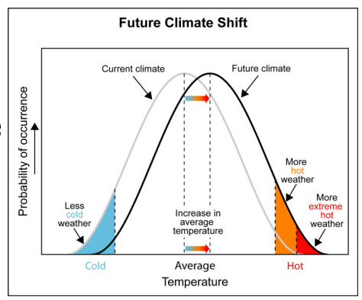
Rank-based Tests
Use ranks of data points.
Wilcoxon Rank Sum Test (Mann-Whitney Test) alternative for two-sample t-test.
Evaluate if two random samples are from same distribution or if shifted in location.

Slide 41

Example: Rank Test
Suppose we have two groups and expression values (log2) for m replicate samples:
x1, x2, . . ., xm for group 1 and
y1, y2, . . ., ym for group 2
Is the distribution of the expression values for these groups significantly different (are they shifted?)

Slide 42
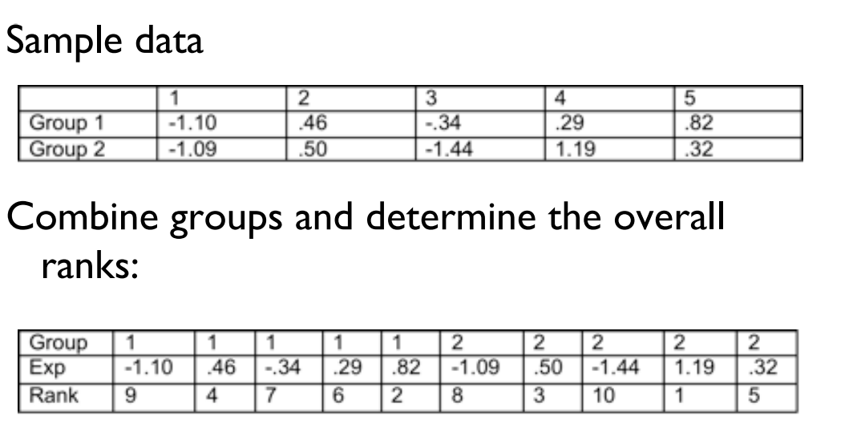
Example: Rank Test
Sample Data (n=5 per group)
Combine groups and determine overall rank:

Slide 43
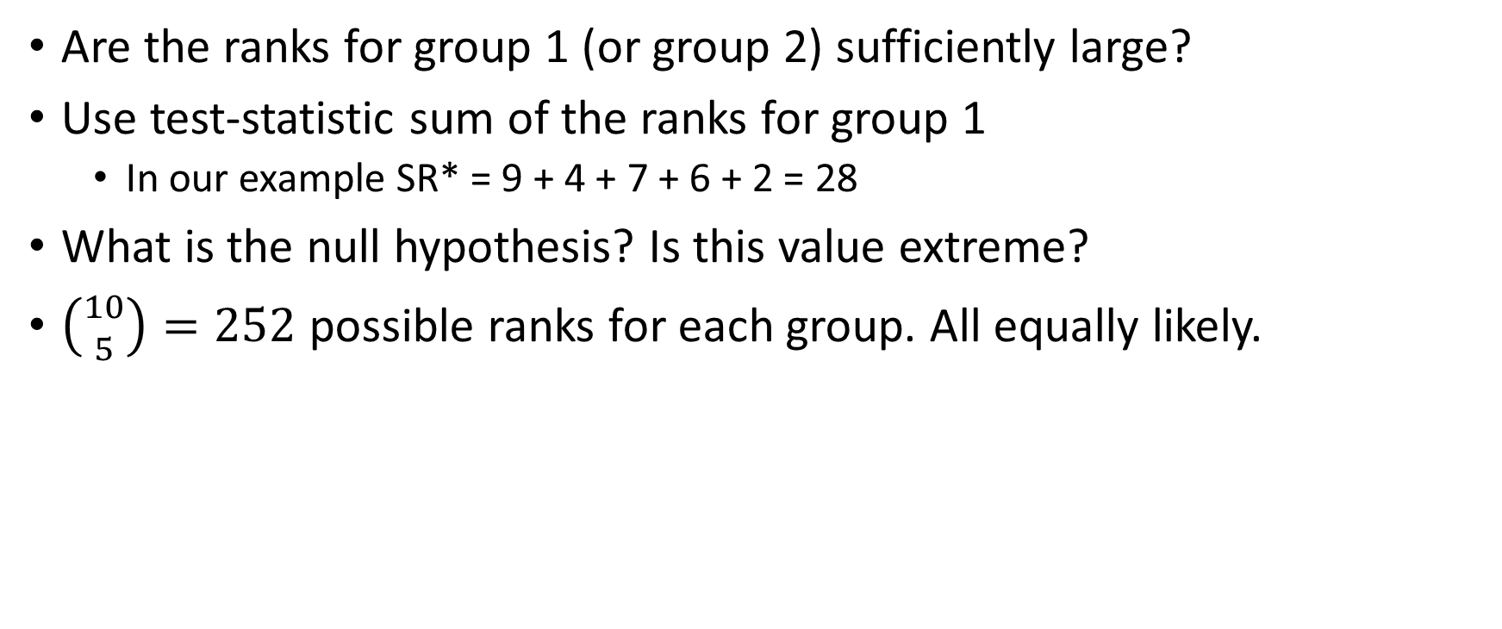
Example: Rank Test
Are the ranks for group 1 (or group 2) sufficiently large?
Use test-statistic sum of the ranks for group 1
In our example SR* = 9 + 4 + 7 + 6 + 2 = 28
What is the null hypothesis? Is this value extreme?
$\left({10 \atop 5}\right)=252$ possible ranks for each group. All equally likely.

Slide 44
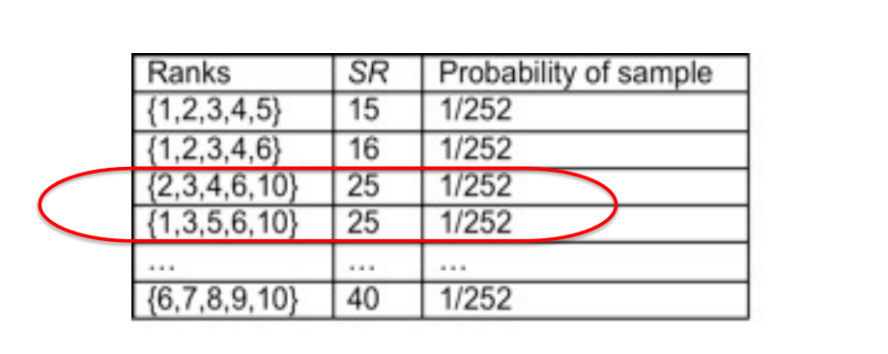
Example: Rank Test
Calculate SR for each possible sample:

Slide 45
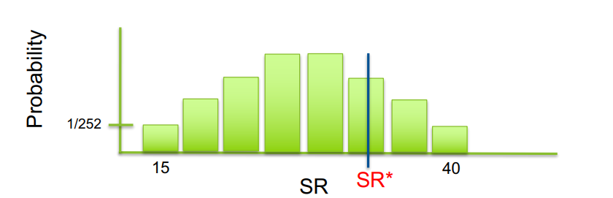
Example: Rank Test
Recall the definition of a p-value!
P(SR ≥ SR*) set to # (SR ≥ SR*)/252
If the sample size is large, can use a Normal approximation

Slide 46
Permutation Testing
To evaluate significance of observed test-statistic
Evaluate all possible values of test-statistic on permuted data sets where the labels have been rearranged on the observed data
The null hypothesis is generated from the permutations (do not need to assume distribution)

Slide 47
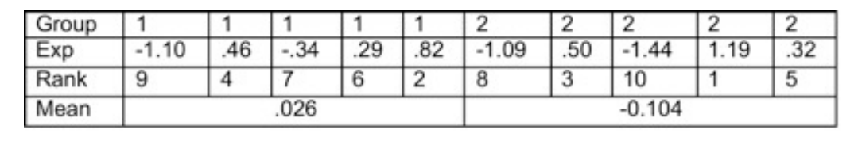
Example: Permutation Test
Calculate t-statistic on previous example
Two-sample t-statistic t* = 0.22
Do not assume t-distribution, use permutations

Slide 48
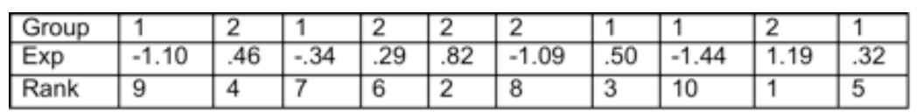
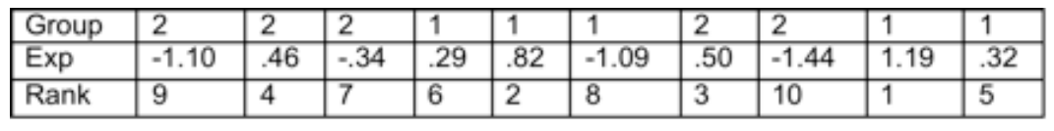
Example: Permutation Test
Permuted data set 1
Two-sample t-statistic t₁ = -1.37
Permuted data set 2
Two-sample t-statistic t₂ = 2.25
…. repeat many times…….

Slide 49
Example: Permutation Test
If sample small enough, all permutations (p) can be evaluated.
Otherwise, sample randomly (e.g., 10000 times) from all possible permutations.
Recall the definition of a p-value!
P(t* ≥ t) = # (t_{p} ≥ t )/ # of permutations
Possible p-values for both examples are discrete
For example: if your t* is lower than all permuted t-values on 10,000 permutations, you would report a p-value < 1/10,000 (or < 1e-04)

Slide 50
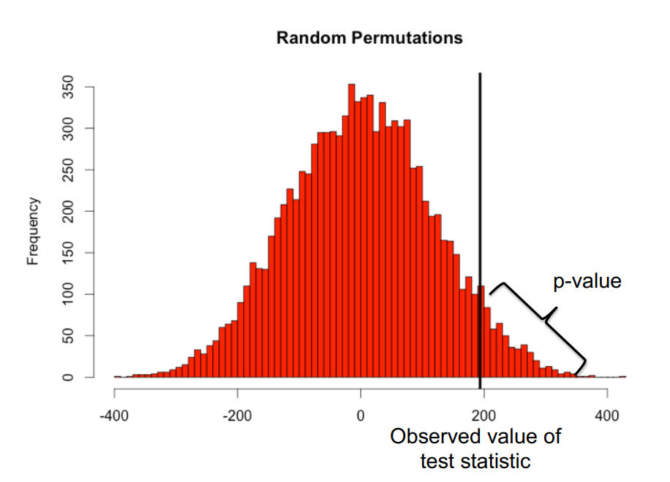
Permutation p-value

Slide 51
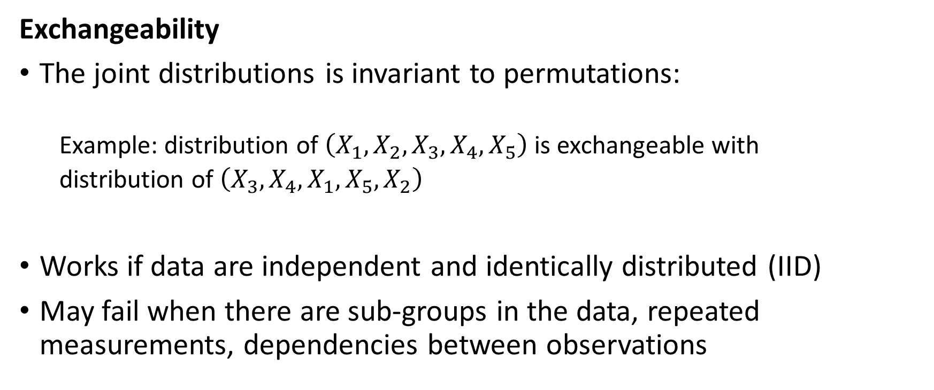
Issues
Exchangeability
The joint distributions is invariant to permutations:
Example: distribution of $\left(X_{1}, X_{2},X_{3}, X_{4},X_{5}\right)$ is exchangeable with
distribution of $\left(X_{3}, X_{4},X_{1}, X_{5},X_{2}\right)$
Works if data are independent and identically distributed (IID)
May fail when there are sub-groups in the data, repeated measurements, dependencies between observations

Slide 52
Issues
Exchangeability (cont.)
e.g., observe heads/tails, but there are two different coins
Need to stratify permutations by sub-group
Perform multi-block permutations
Practical Concerns
n too small – not enough permutations (e.g., n=10, 2 groups – 252 permutations)
n big – cannot do all, randomly sample

Slide 53
Bootstrapping
What if you want to get a confidence interval or standard error on an estimate that is not parametric?
Draw sample
*with* replacement – original sample size n
Repeat to obtain B bootstrap samples – B = 100, 1000
For each b=1,2, … B bootstrap samples, calculate statistic S_{b}
Obtain sampling distribution of statistic S – Estimate standard error, confidence interval, etc.

Slide 54
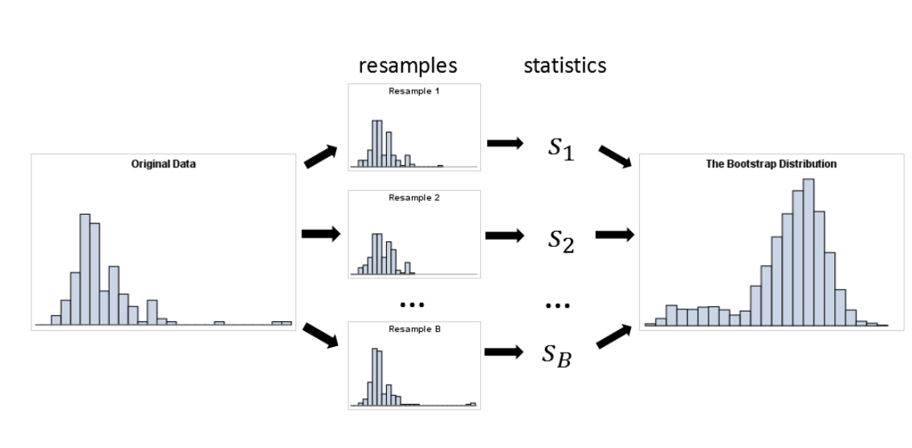
Example: Bootstrapping

Slide 55
Bootstrap Properties
Sample variance of statistic S converges to true variance as B->infinity
Straightforward
Check stability of results
Useful for complex estimators

Slide 56
Permutation/Bootstrap Note
Save seed to reproduce results!

Slide 57
Conclusions

Slide 58
What did we learn?
Multiple testing burden needs to be dealt with
Histogram of p-values and Q-Q plots are good ways to visualize p-values
There are various ways to correct for multiple testing (Bonferroni, FDR)
Permutations and bootstrapping is a great way to tackle non-parametric tests

